Slide 1

inal Presentation
Evaluation of Vision Zero
Non-Vehicle Group

Slide 2
Table of Contents
1
2
3
Background
Evaluation of Vision Zero
Conclusions
Cycling Trends in NYC
Exploratory Data Analysis
Summary of Evaluation
Overview of Vision Zero
Qualitative Evaluation
Recommendations
Recap of Proposal
Quantitative Evaluation
Notes:
Here is an overlook of what our presentation is composed of.
The first part is background, we are going to cover cycling trends in nyc, an overview of Vision Zero and Recap our Proposal to give you guys a rough idea of what to expect.
The second part, we are going to evaluate the effectiveness of vision zero based on time series data analysis, qualitative and quantitative evaluation.
Finally, comes to the conclusions, we are going to summarize the evaluation and give some recommendations for vision zero.

Slide 3
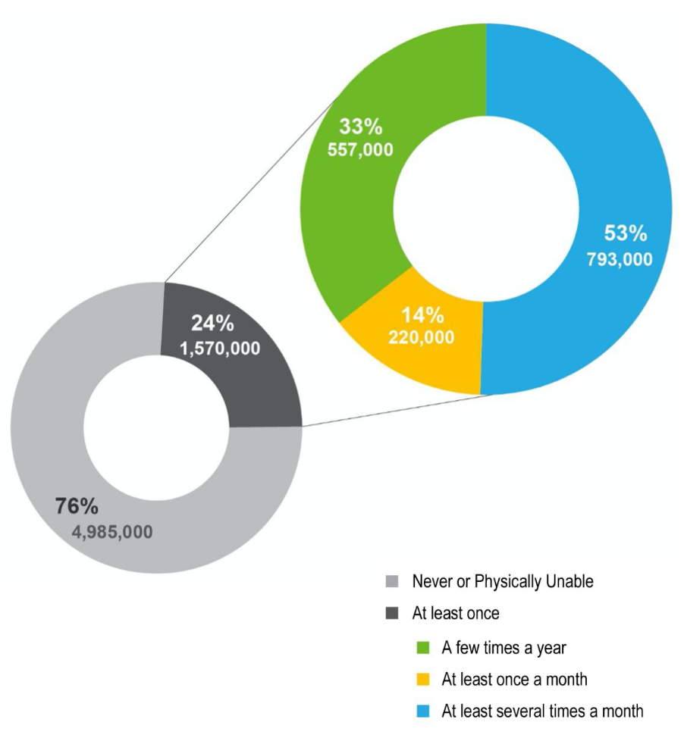

Cycling Trends in NYC
1
Percent of Adult New Yorkers Who Ride a Bike
On a typical day, there are about
490,000 cycling trips
made in New York City.
“
”
Source: U.S. Census Bureau’s American Community Survey Journey to Work 2017
Background
Evaluation of Vision Zero
Conclusions
Notes:
Now, we are going to analyze the cycling trends in new york city. From the sector diagram “percent of adult new yorkers who ride a bike” that nearly one quarter of adult New Yorkers ride a bike, which are nearly 1.6 million people, . Among those people, more than half of the population (blue area) ride a bike at least several times a month. We can see there is a large population in nyc ride a bike.
We can conclude that the cycling demand is hugh in NYC that there are about 490,000 cycling trips made in NYC on a typical day.

Slide 4
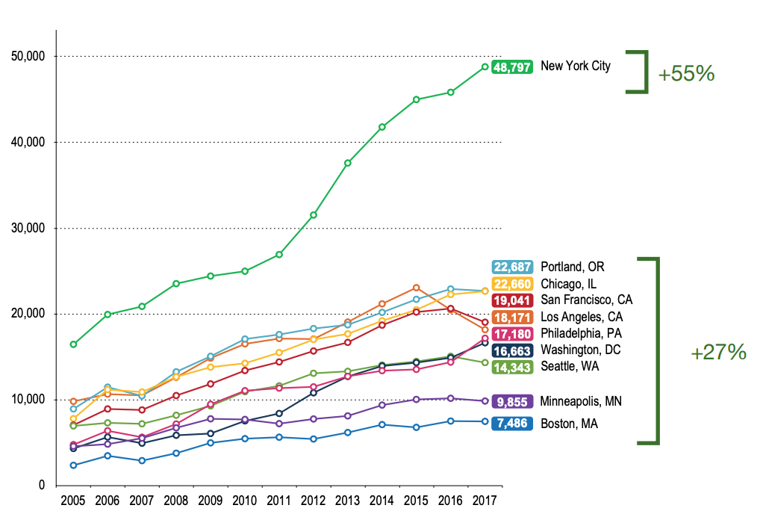
Cycling Trends in NYC
1
Commute to Work by Bicycle
+55%
Cycling to work in NYC has grown
2X faster
as other major cities.
2012 - 2017
“
+27%
”
Source: U.S. Census Bureau’s American Community Survey Journey to Work 2017
Background
Evaluation of Vision Zero
Conclusions
Notes:
Last slide we talked that the demand of cycling is huge. Now we will focus on the GROWTH of this demand.
From the graph on the right we can see that New Yorkers commute to work by bicycle has increased 55%, which is 2 times faster than other cities. So, we can conclude that cycling to work in NYC has grown 2 times faster as other major cities.
It is because the high demand of cycling trends in nyc, vision zero plan was created by New York City Mayor Bill de Blasio in 2014.

Slide 5
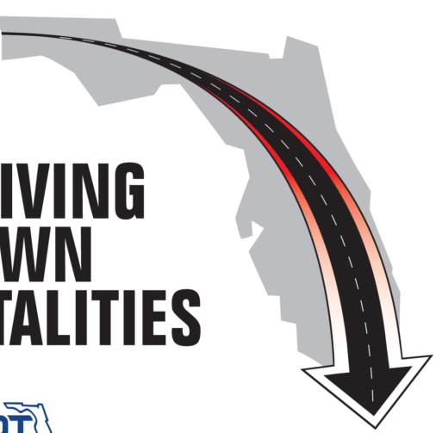

Overview of Vision Zero
1
KSI
Eliminate
Fatalities and
Serious Injuries
In New York City by 2024
0
Background
Evaluation of Vision Zero
Conclusions
Notes:
Its purpose is to eliminate fatalities and serious injuries on New York City streets by 2024^{[1]}. Vision Zero in New York City is based on a similar program of the same name that was implemented in Sweden.
from implementation of the plan through 2018， the deaths in New York City have been decreasing, however, traffic injuries and crashes have been increasing. Therefore, it is important for us to examine the effectiveness of Vision Zero.

Slide 6

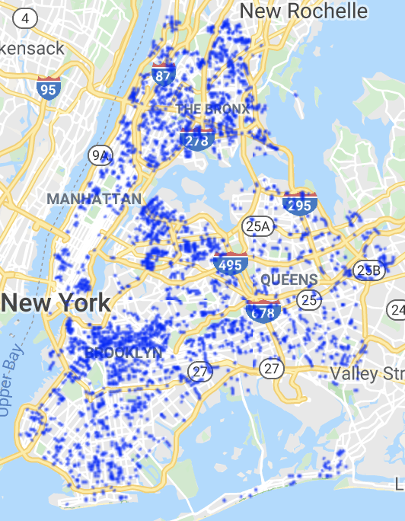
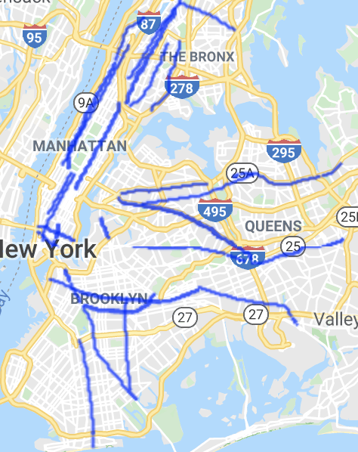
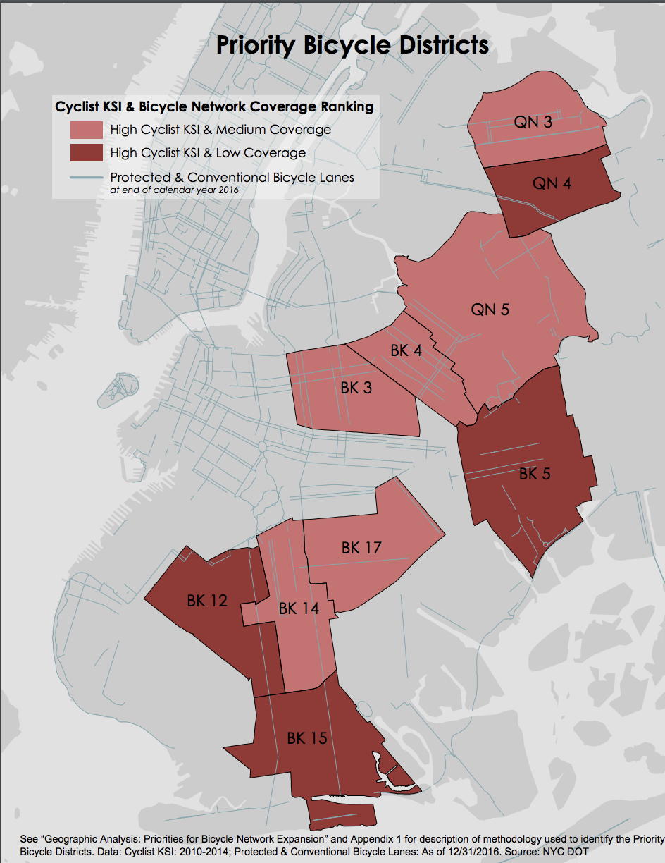
Overview of Vision Zero
1
Highlighted Initiatives:
- a raised area of a roadway designed to reduce vehicle speeds
- neighborhoods with high numbers of cyclist KSI (Killed or Seriously Injured) and few dedicated bicycle facilities.
1.Speed Humps
2. Arterial Slow Zones
3. Bike Priority Areas
- a combination of a lower speed limit, signal timing changes, distinctive signs and increased enforcement
Background
Evaluation of Vision Zero
Conclusions
Notes:
Among 63 initiatives, our team picked these 3 highlighted initiatives to take a closer look because they are bike related, measurable and offer us more data to work with.
The first initiative is about Speed Humps, which …

Slide 7
Overview of Vision Zero
1
Highlighted Initiatives:
- a raised area of a roadway designed to reduce vehicle speeds
2. Arterial Slow Zones
1.Speed Humps
- neighborhoods with high numbers of cyclist KSI (Killed or Seriously Injured) and few dedicated bicycle facilities.
3. Bike Priority Areas
- a combination of a lower speed limit, signal timing changes, distinctive signs and increased enforcement
Background
Evaluation of Vision Zero
Conclusions

Slide 8
Overview of Vision Zero
1
Highlighted Initiatives:
- a raised area of a roadway designed to reduce vehicle speeds
- neighborhoods with high numbers of cyclist KSI (Killed or Seriously Injured) and few dedicated bicycle facilities
1.Speed Humps
2. Arterial Slow Zones
3. Bike Priority Areas
- a combination of a lower speed limit, signal timing changes, distinctive signs and increased enforcement
Background
Evaluation of Vision Zero
Conclusions

Slide 9



Recap of Proposal
1
Research Question 1
Research Question 1
Do the current 10 priority bicycle districts best represent the areas that need ridership safety attention?
Research Question 2
What is the impact of Speed Hump Policy on bicycle fatalities and injuries?
Research Question 3
Do fatality and injury rate differ on 3 classes of bike lanes?
What is the probability that a cyclist gets killed or injured with different initiatives implemented?
Revised due to lack of related data
Background
Evaluation of Vision Zero
Conclusions
Notes:
After the introduction of 3 initiatives, here is the recap of our proposal. We keep the first 2 research questions as they are, which are “do the current…” and “what is…”. For the 3rd research question, our original questions is do fatality and injury rate differ on 3 classes of bike lanes. However, due to the limitation of data, we revised it into “what is the probability…”

Slide 10
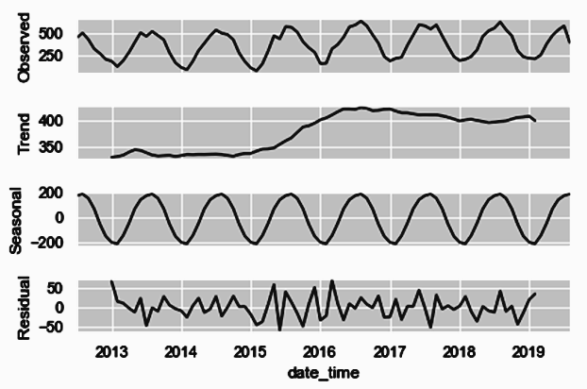
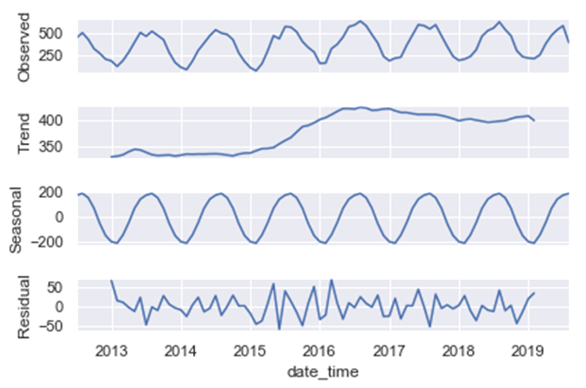
Time Series Analysis
2
Observation =
Trend + Seasonal + Residual
Background
Evaluation of Vision Zero
Conclusions
Notes:
So far, I believe you guys have a good knowledge of what is vision zero and our team’s approaches to evaluate it.
Now comes to the second part, evaluation of vision zero. We are going to start with time series analysis.
We can see that the observation graph on the top has 3 components, trend, seasonal and residual.
For our analysis, we will only focus on trend and seasonal graphs.

Slide 11
Time Series Analysis
2
A spike from 2015 to 2016
Background
Evaluation of Vision Zero
Conclusions
Notes:
Looking at the trend graph, we can observe that there was a huge increase of cyclists getting injured from 2015 to 2016, which may seem like the roads have become more dangerous. However, it is not true. It is because the total cyclists population has increased significantly during that period of time because of 2 reasons.
The first reason is that NYPD started to use an electronic reporting system, which allows NYPD to record more data than before.
The introduction of bike share that encouraged more people cycling.

Slide 12
Time Series Analysis
2
A spike from 2015 to 2016
Evaluation:
2013 VS 2014
&
2017 VS 2018
Background
Evaluation of Vision Zero
Conclusions
Notes:
Because of the sharp increase from 2015 to 2016, we will exclude this period for a fairer comparison, focusing on analysis between 2013 versus 2014 and 2017 versus 2018.

Slide 13
Time Series Analysis
2
The majority of cyclist injuries and fatalities occurred from March to September of each year
Background
Evaluation of Vision Zero
Conclusions
Notes:
Now looking at the seasonal graph, we can see there is a seasonal trend that for months above the dashed line, which is from March to September, the number of injuries is peak. That is probability because the weather is warmer and nicer in those months that naturally more people would go on street cycling.

Slide 14
Time Series Analysis
2
The majority of cyclist injuries and fatalities occurred from March to September of each year
Recommendations:
Install facilities before March
Increase the number of educational programs from March to September
Background
Evaluation of Vision Zero
Conclusions
Notes:
So, what can we do to solve the issue that a lot of cyclists get injured and killed in those months every year? We came up with 2 recommendations.
To install facilities before March, so that the city can be prepared before the warmer season comes.
To increase the educational programs during peak period, since education is critical to ensuring everyone who uses our roads knows how to safely navigate the streets. We can also expand the depth and breadth of these programs with a focus on rules of the road and vehicle-cyclist interaction.

Slide 15
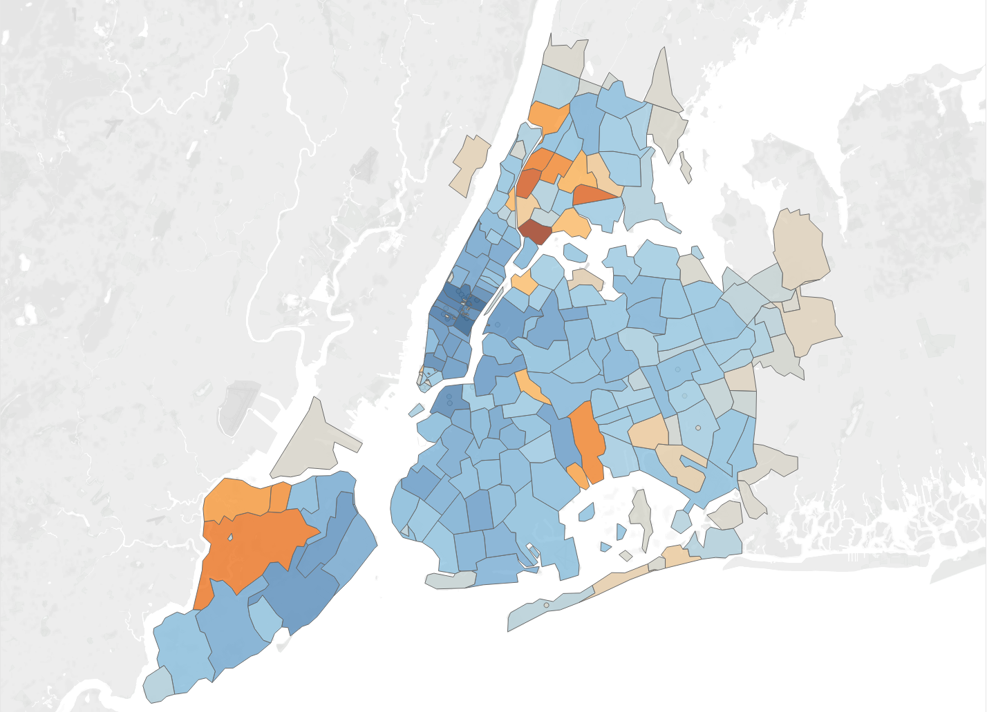
Spatial Analysis
2
Number of killed and injured cyclists
😫
😊
Most places have seen a decrease in the number of killed and injured cyclists
Bronx & Staten Island 😫
Midtown Manhattan 😊
😫
Background
Evaluation of Vision Zero
Conclusions
Notes:
In addition to the time series analysis, we also did spatial analysis to see Change of the number of cyclist killed or injured by zipcode
We found that 1) most of the places are becoming safer especially Midtown Manhattan 2) However, the number of cyclist injured or killed increased in Bronx and Staten Island
And we are going to take a closer look into those areas
Average change in number of killed and injured cyclist of each zipcode
Top 5 red places:
10454 Bronx
10452 Bronx
10472 Bronx
10314 Staten Island
10453 Bronx
Top 5 Blue places
10022 Midtown East
10016 Midtown East
10019 Theater district
10036 Hell’s kitchen
10001 High Line

Slide 16
Spatial Analysis - Case Study
2
 |  | 😊 Midtown Manhattan
Speed Hump | 6370 | 1700
Arterial Slow Zone | 4078 | 7427
Signal Timing | 9818 | 33067
Left Turn Traffic Calming | 227 | 8094
😫
Bronx
Hypothesis:
Speed humps are ineffective
Background
Evaluation of Vision Zero
Conclusions
Notes:
Midtown Manhattan outnumbered Bronx in many other initiatives
Bronx: more speedhump, but it is becoming more dangerous
Hypothesis: does work very well in terms of reducing fatality and injury rate of cyclists
Speed humps: continous raised areas that span the entire road https://www1.nyc.gov/html/dot/html/pedestrians/traffic-calming.shtml
Enhanced crossings: gives pedestrian a place to cross the road when there is no traffic signal set at the crossroad. Usually set at low traffic area like school and park where the traffic volume does not meet the standard to set traffic signal.
Conclusion: Speed Hump and enhanced crossings have no use. And logistics regression will further confirm our hypotheis
Average change in number of killed and injured cyclist of each zipcode
Top 5 red places:
10454 Bronx
10452 Bronx
10472 Bronx
10314 Staten Island
10453 Bronx
Top 5 Blue places
10022 Midtown East
10016 Midtown East
10019 Theater district
10036 Hell’s kitchen
10001 High Line

Slide 17
Regression Result
2
Initiatives | Negative Changes | Positive Changes | Insignificant
Arterial Slow Zones
Neighborhood Slow Zones
Signal Timing
Speed Humps
Enhanced Crossings
Left Turn Traffic Calming
✓
✓
The implementation of the Arterial Slow Zones initiative helps to reduce the number of cyclists injured or killed in the event of a collision.
✓
✓
✓
✓
Background
Evaluation of Vision Zero
Conclusions
Notes:
Probability of a Cyclist got killed or injured when a collision happened
Run a logistics regression
Among the three initiatives we are interested in,
We still have bile priority district to be examined, since this is the initiative specifically designed for bike riders, we will spend more time evaluating it.
For logistic regression,
(1) observations: among all collision events, only collision events near or within 7 initiatives regions are considered (i.e. arterial, bike, cross, slow, left, signal, speed_hump)
(2) features: time (i.e. year, month, day_of_week, and hour) and whether an event is before/after initiatives (-> False/True)
(3) output: whether the number of cyclists injured or killed is zero or nonzero (-> False/True)
Result:
(1) the probability output of the logistic regression can be interpreted as a conditional probability - given a collision event, how likely the event involves cyclist injured or killed (i.e. non-zero number of cyclists injured or killed).
(2) statistically significant (negative): Arterial_Slow_Zones
(3) statistically significant (positive): Neighborhood_Slow_Zones, Signal_Timing
(4) statistically insignificant: Bike_Priority_Districts, Enhanced_Crossings, Left_Turn_Traffic_Calming, Speed_Humps
(5) conclusion: Suppose that a collision event occurs, the initiative that, when it is enforced, makes the event less involve cyclist injured or killed is the ‘Arterial_Slow_Zones’ initiative. (???)
For this one we need to convert the coef into the odd i take a look : this is the odd ratio of the factors:
[1] 0.9977026 1.0401865 1.0044097 0.8136703 1.0369669 1.0611996
[7] 1.3866628 1.1728070 1.1697616 1.0356197
ref) http://www.nyc.gov/html/visionzero/pages/initiatives/street-design.shtml
---

Slide 18
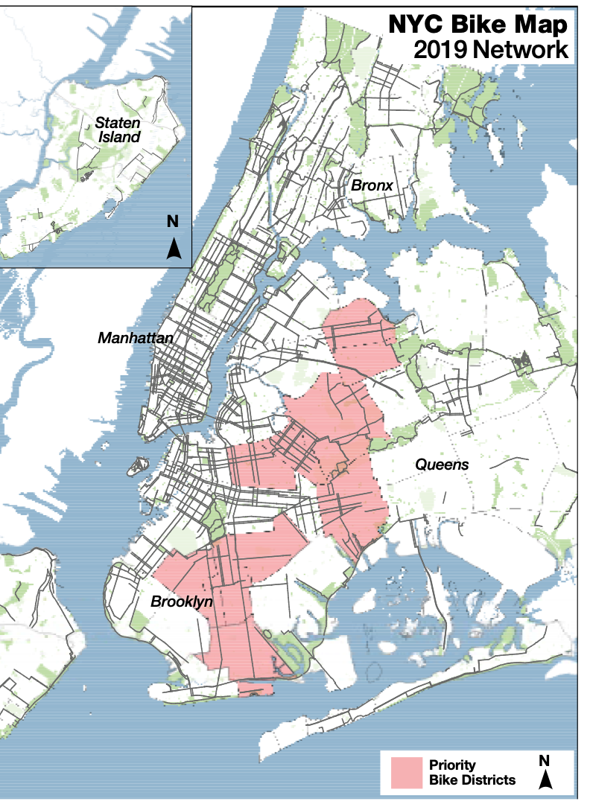
Evaluation of Bike Priority Districts
2
Bike Priority Districts
Number of cyclists injured or killed
2017 ⇨ 2018
↓ 4.61%
Other: ↓ 3.43%
Source: https://www1.nyc.gov/html/dot/downloads/pdf/bike-safety-plan.pdf
Background
Evaluation of Vision Zero
Conclusions
Notes:
From 2017 to 2018, the number of cyclist killed or injured in the ten bike priority districts decreased by 4.6% which slightly higher than the rest of places.
We can say that the bike priority district is making the places safer
Slide 3 is more relative to the evaluation of the action plan and we picked two initiatives - bike zone and speed hump. By comparing the change of the number of injuries/fatalities between all regions in NYC and the regions with initiatives implemented from 2013 to 2014 and from 2017 to 2018, we can see that the decrease in the regions with initiatives implemented is greater than that in all regions in NYC (except Speed hump in 2018?) so this indicates that the initiatives are effective.

Slide 19
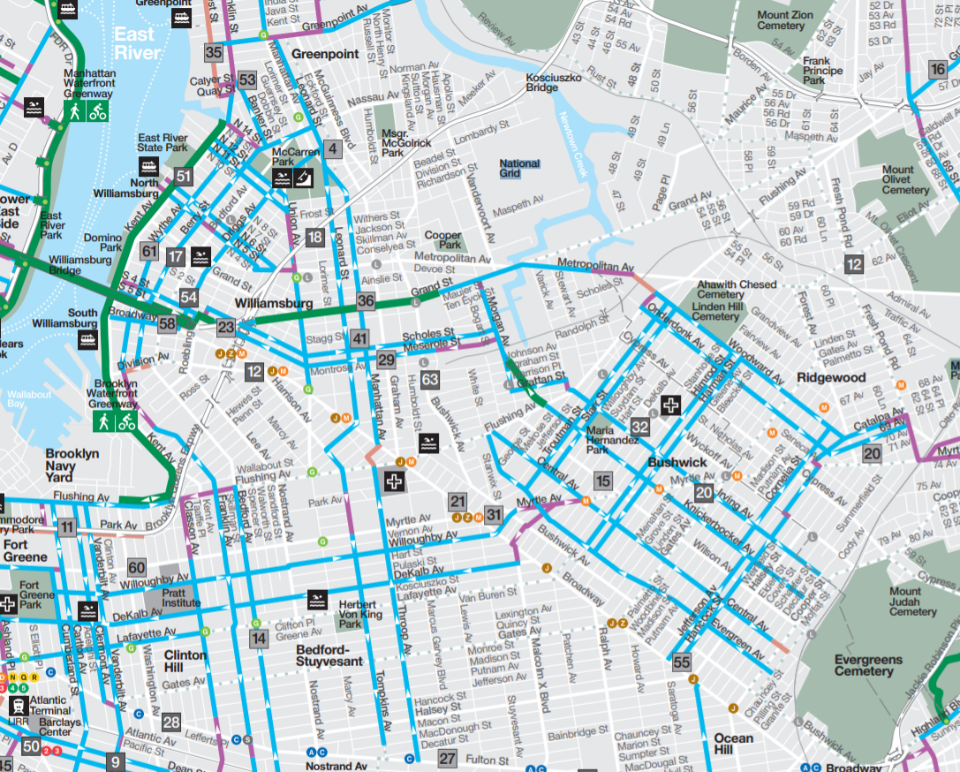
Facilities Coverage in Prioritized Bike Districts
2
Bike Priority Districts
Bike Facilities
Source: https://www1.nyc.gov/html/dot/downloads/pdf/bikemap-2019.pdf
Background
Evaluation of Vision Zero
Conclusions
Notes:
Before we get into this part, I would like to give you some background in how DOT picked the ten prioritized districts: KSI + low bike facilities coverage, these regions are given priority when there is plan to build more bike facilities and this initiative started in 2016.
When we checked the bike map of 2019 provided by department of transportation we found the many prioritized bike districts now have launched plenty of bike facilities. For example in this map, you can see the region is covered with all kinds of bike facilities
These region have been take care of and this information needs to be updated

Slide 20
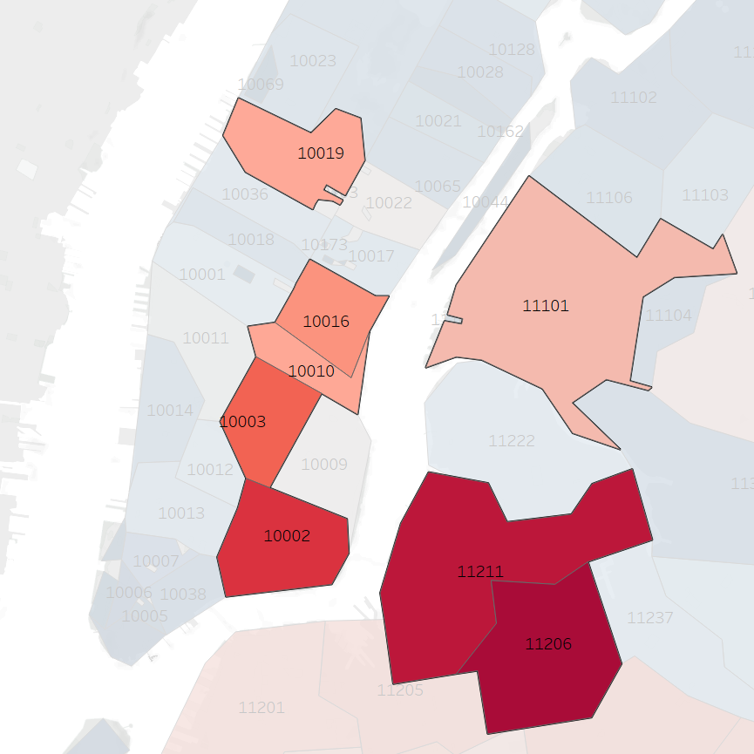
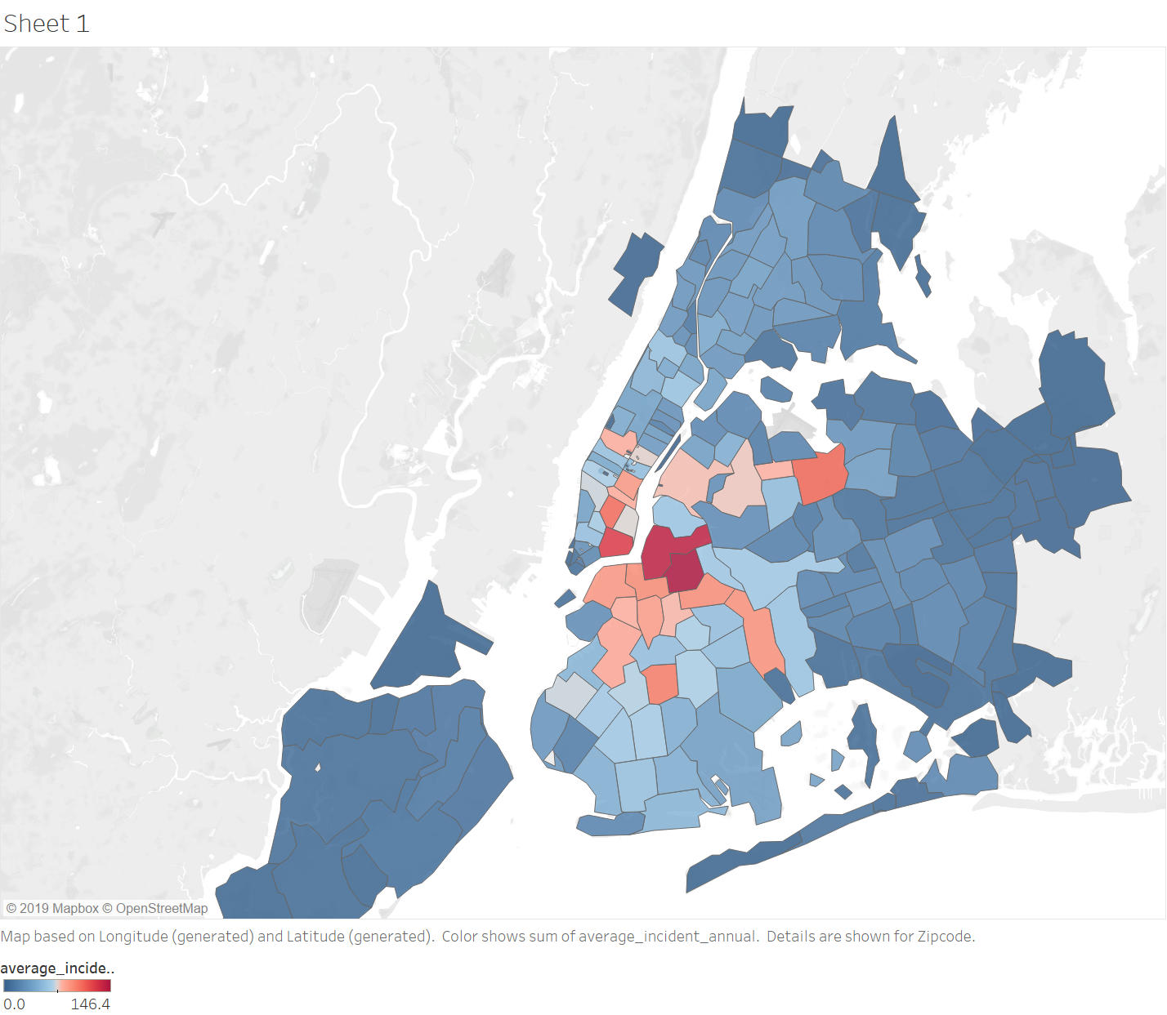
Cyclist Safety Map vs Bike Priority Districts
2
Cyclist Safety Map
Bike Priority Districts
Background
Evaluation of Vision Zero
Conclusions
Notes:
In addition to the places with low bike facilities coverage and high KSI, we also looked into places where there are a lot of bike facilities, however still dangerous. Plotted the total number of cyclists injured and killed in the map and create a cyclist safety map. We can tell that the lower east side of Manhattan and Williamsburg area is pretty dangerous. It raised a question that even if there are many facilities designed to protect the bike riders, why the KSI is still so high. Of course the cause can be complicated, but it reminds us that further research is needed in those regions, because in the future, when we build more bike facilities, we want all the bike facilities that we build to reduce the KSI, insteading of working the other way around

Slide 21
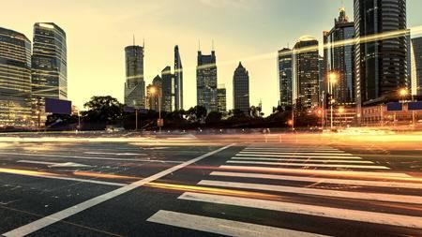

Summary of Evaluation
3
Seasonality trend in cyclist injuries and fatalities
1
Background
Evaluation of Vision Zero
Conclusions
Notes:
There is a seasonality trend in cyclist injuries and fatalities, which is that more incidents happen from March to September.
The Speed Hump Policy is effective in decreasing cyclists’ fatality and injury rate.
The Arterial Slow Zones initiative is effective in decreasing cyclists’ fatality and injury rate.
Based on our Cycling Risk Score, the current 10 priority bicycle districts do not best represent the areas that need ridership safety attention

Slide 22
Summary of Evaluation
3
Seasonality trend in cyclist injuries and fatalities
1
2
The Speed Hump Policy is ineffective in decreasing cyclists’ fatality and injury rate
Background
Evaluation of Vision Zero
Conclusions
Notes:
There is a seasonality trend in cyclist injuries and fatalities, which is that more incidents happen from March to September.
The Speed Hump Policy is effective in decreasing cyclists’ fatality and injury rate.
The Arterial Slow Zones initiative is effective in decreasing cyclists’ fatality and injury rate.
Based on our Cycling Risk Score, the current 10 priority bicycle districts do not best represent the areas that need ridership safety attention

Slide 23
Summary of Evaluation
3
The Arterial Slow Zones initiative is effective in decreasing cyclists’ fatality and injury rate
Seasonality trend in cyclist injuries and fatalities
3
1
2
The Speed Hump Policy is ineffective in decreasing cyclists’ fatality and injury rate
Background
Evaluation of Vision Zero
Conclusions
Notes:
There is a seasonality trend in cyclist injuries and fatalities, which is that more incidents happen from March to September.
The Speed Hump Policy is effective in decreasing cyclists’ fatality and injury rate.
The Arterial Slow Zones initiative is effective in decreasing cyclists’ fatality and injury rate.
Based on our Cycling Risk Score, the current 10 priority bicycle districts do not best represent the areas that need ridership safety attention

Slide 24
Summary of Evaluation
3
The Arterial Slow Zones initiative is effective in decreasing cyclists’ fatality and injury rate
Seasonality trend in cyclist injuries and fatalities
3
1
4
Cyclist Safety Map shows that the current 10 priority bicycle districts do not best represent the areas that need ridership safety attention
2
The Speed Hump Policy is ineffective in decreasing cyclists’ fatality and injury rate
Background
Evaluation of Vision Zero
Conclusions
Notes:
There is a seasonality trend in cyclist injuries and fatalities, which is that more incidents happen from March to September.
The Speed Hump Policy is effective in decreasing cyclists’ fatality and injury rate.
The Arterial Slow Zones initiative is effective in decreasing cyclists’ fatality and injury rate.
the current priority bicycle district are not the best representatives of the areas that need ridership safety attention

Slide 25
Recommendations
3
The Arterial Slow Zones initiative is effective in decreasing cyclists’ fatality and injury rate.
Seasonality trend in cyclist injuries and fatalities
3
Install facilities before March;
Increase the number of educational programs from March to September
1
4
Cyclist Safety Map shows that the current 10 priority bicycle districts do not best represent the areas that need ridership safety attention
2
The Speed Hump Policy is ineffective in decreasing cyclists’ fatality and injury rate
Background
Evaluation of Vision Zero
Conclusions
Notes:
Install facilities before March to ensure the running of facilities during March to September and increase the number of educational programs during that time period.
Add more speed humps on
11206 Brooklyn (a district next to Williamsburg)
11211 Williamsburg, Brooklyn
10002 Lower East Side
11368 Queens (Queens Zoo)
10003 Union Square
, regions where Cycling Risk Score is high.
Invest more budget on the The Arterial Slow Zones initiative.
Add A,B,C,D,E additional regions to the current 10 priority bicycle districts based on our Cycling Risk Score.

Slide 26
Recommendations
3
The Arterial Slow Zones initiative is effective in decreasing cyclists’ fatality and injury rate.
Seasonality trend in cyclist injuries and fatalities
Increase the budget on the the Arterial Slow Zones initiative.
3
Install facilities before March;
Increase the number of educational programs from March to September
1
4
Cyclist Safety Map shows that the current 10 priority bicycle districts do not best represent the areas that need ridership safety attention
2
The Speed Hump Policy is ineffective in decreasing cyclists’ fatality and injury rate
Decrease the budget on installing speed humps
Background
Evaluation of Vision Zero
Conclusions
Notes:
Install facilities before March to ensure the running of facilities during March to September and increase the number of educational programs during that time period.
Add more speed humps on A,B,C,D,E, regions where Cycling Risk Score is high.
Invest more budget on the The Arterial Slow Zones initiative.
Add A,B,C,D,E additional regions to the current 10 priority bicycle districts based on our Cycling Risk Score.

Slide 27
Recommendations
3
The Arterial Slow Zones initiative is effective in decreasing cyclists’ fatality and injury rate.
Seasonality trend in cyclist injuries and fatalities
Increase the budget on the the Arterial Slow Zones initiative.
3
Install facilities before March;
Increase the number of educational programs from March to September
1
4
Cyclist Safety Map shows that the current 10 priority bicycle districts do not best represent the areas that need ridership safety attention
2
The Speed Hump Policy is ineffective in decreasing cyclists’ fatality and injury rate
Re-prioritize areas that actually need attention based on cyclist safety map
Decrease the budget on installing speed humps
Background
Evaluation of Vision Zero
Conclusions
Notes:
Install facilities before March to ensure the running of facilities during March to September and increase the number of educational programs during that time period.
Add more speed humps on A,B,C,D,E, regions where Cycling Risk Score is high.
Invest more budget on the The Arterial Slow Zones initiative.
Exclude areas that have been taken care of, and add more that needs attention

Slide 28
hank You
Evaluation of Vision Zero
Non-Vehicle Group

Slide 29
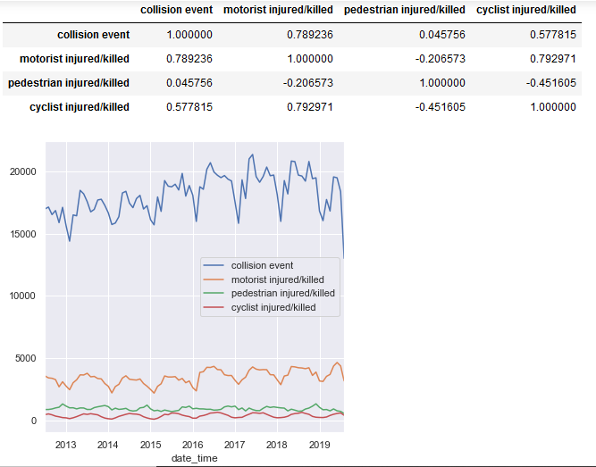
Correlation Matrix

Slide 30
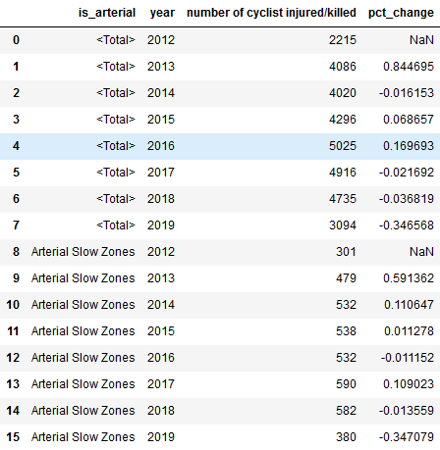
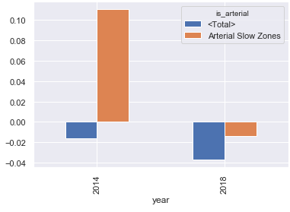
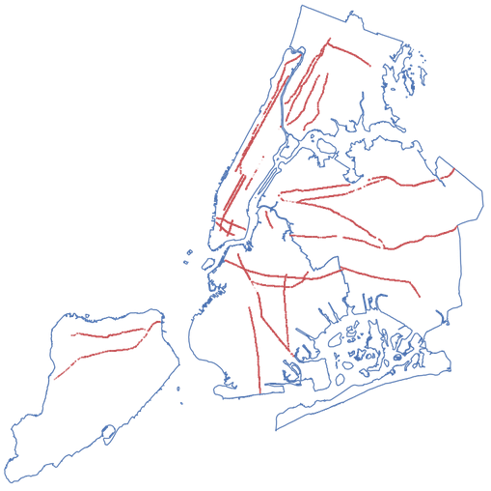
Change rate -- Arterial Slow Zones

Slide 31
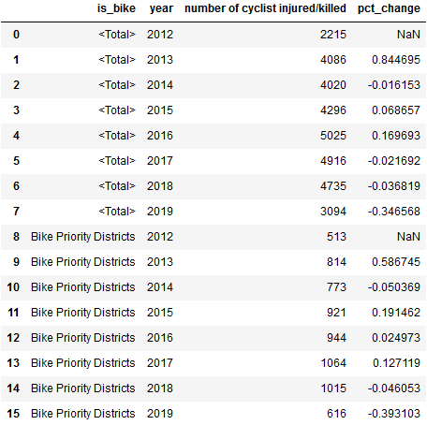
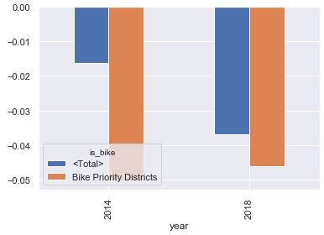
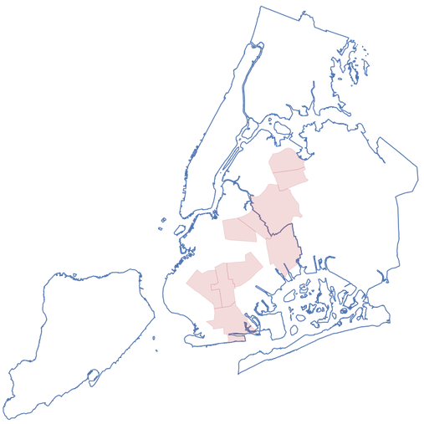
Change rate -- Bike Priority Districts

Slide 32
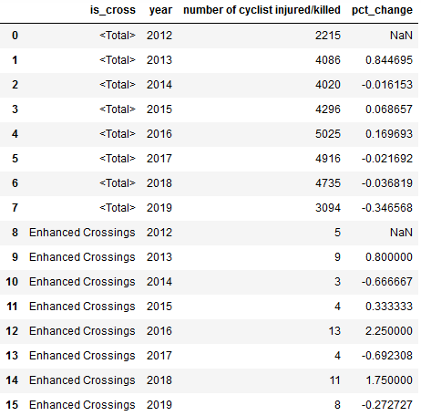
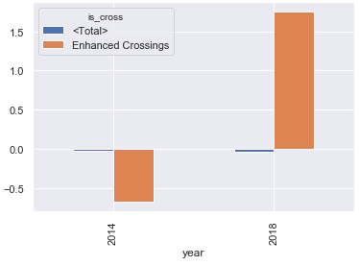
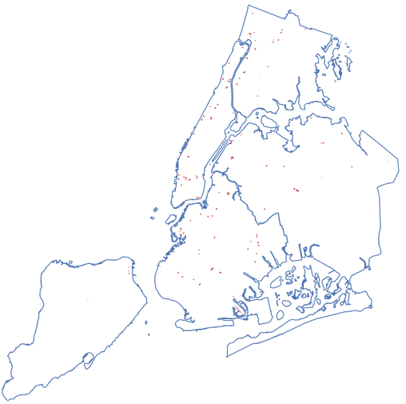
Change rate -- Enhanced Crossings

Slide 33
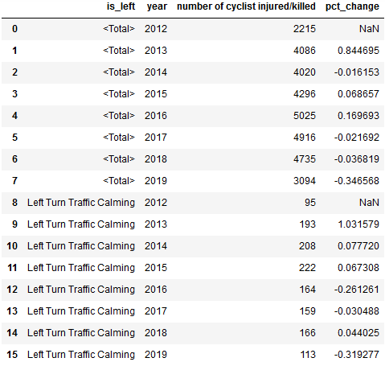
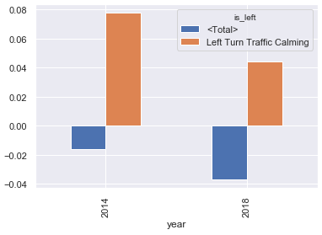
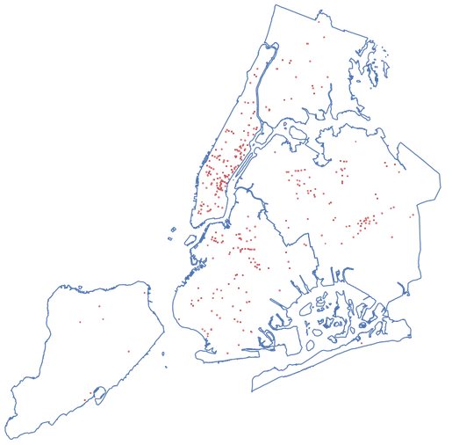
Change rate -- Left Turn Traffic Calming

Slide 34
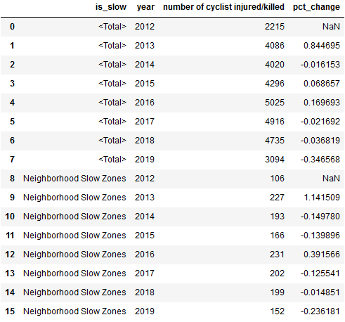
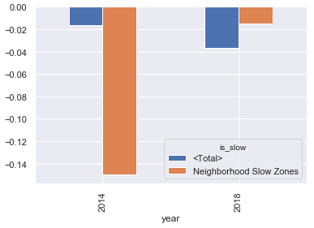
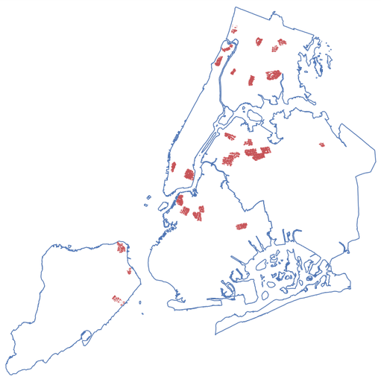
Change rate -- Neighborhood Slow Zones

Slide 35
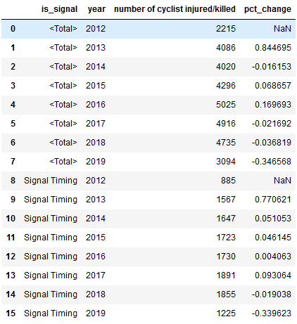
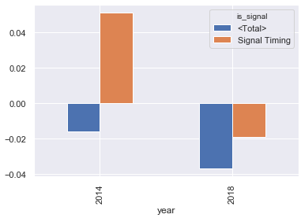
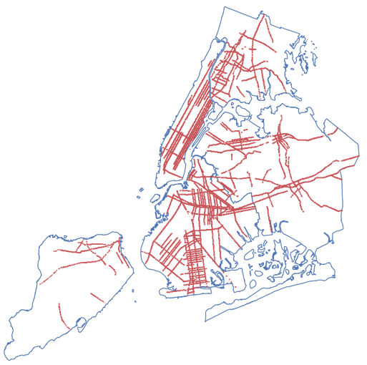
Change rate -- Signal Timing

Slide 36
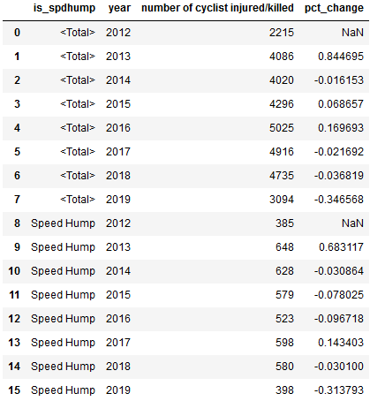
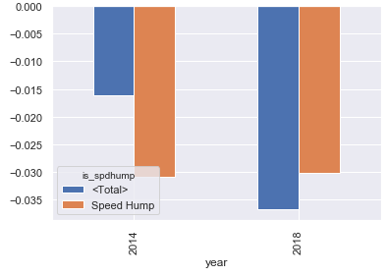
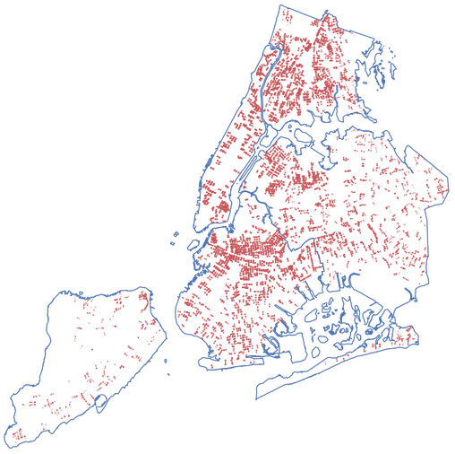
Change rate -- Speed Humps

Slide 37
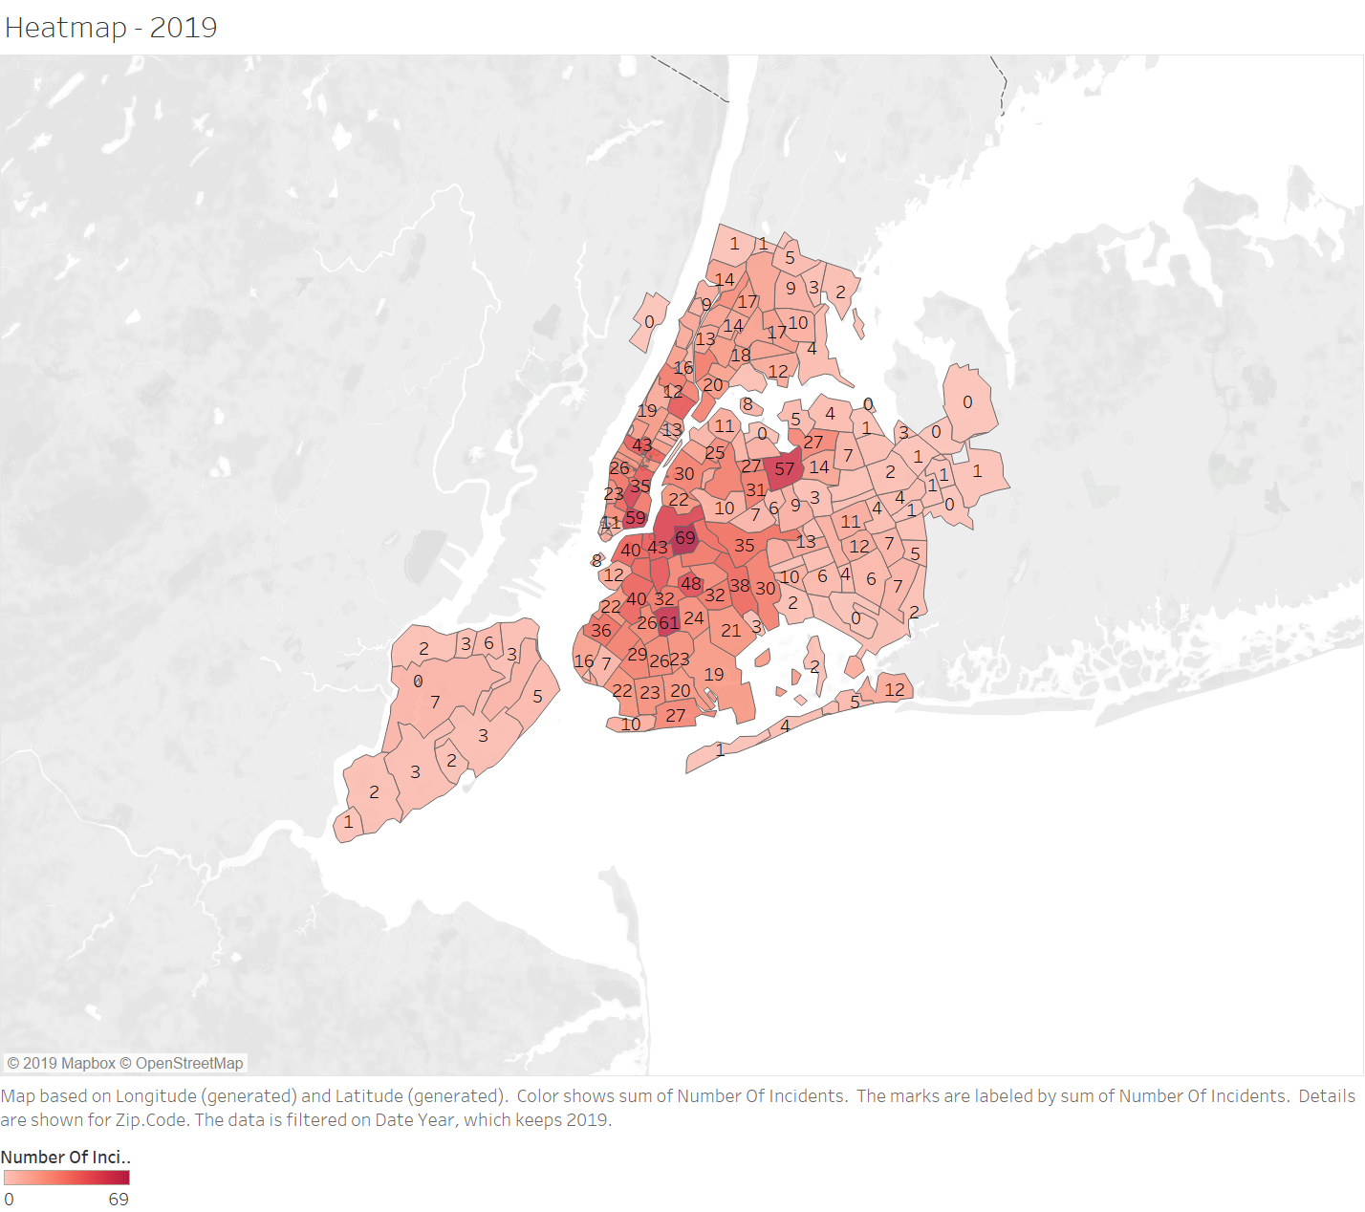

Cycling Risk Score Heatmap (1)

Slide 38

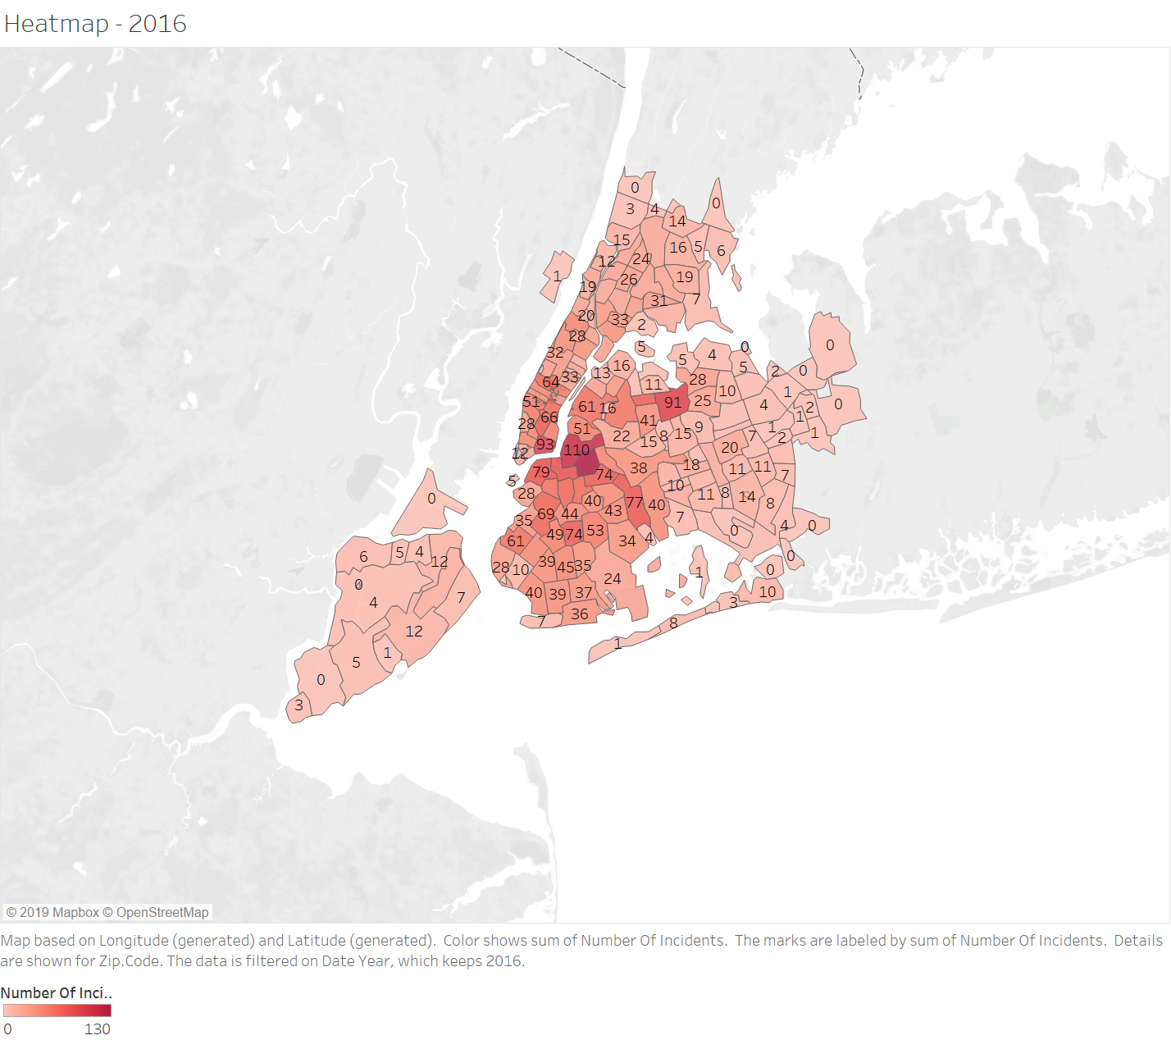
Cycling Risk Score Heatmap (2)

Slide 39


Cycling Risk Score Heatmap (3)

Slide 40
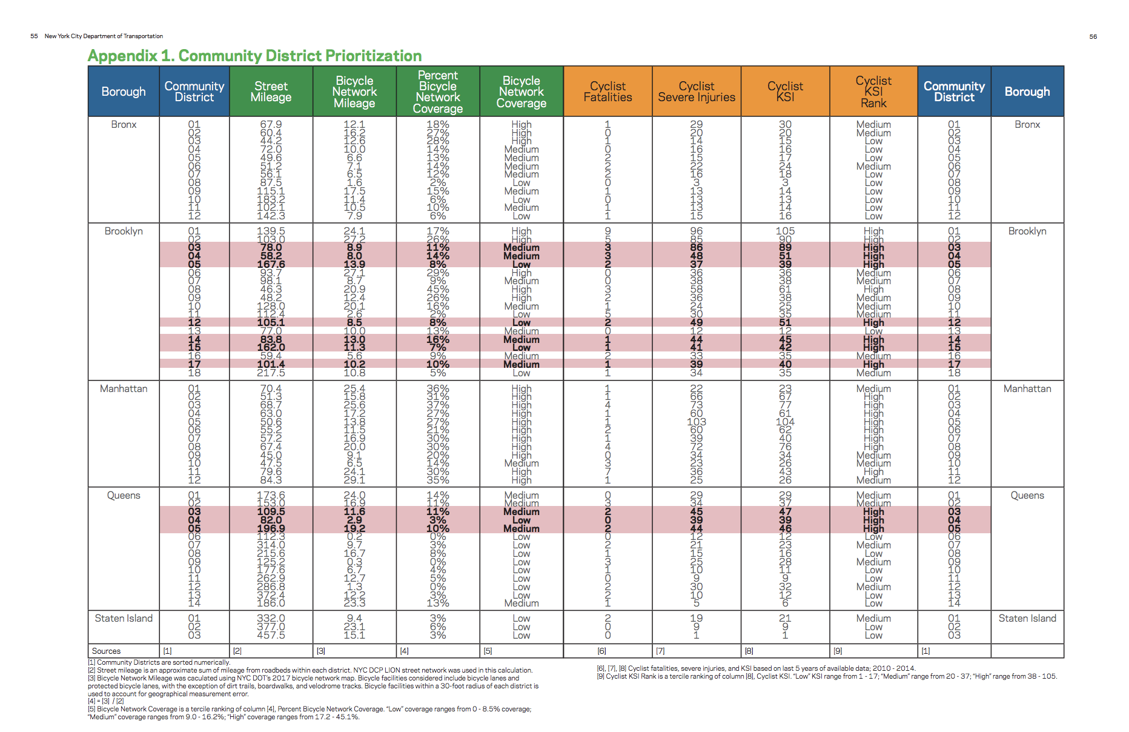
“Safer Cycling: Bicycle Ridership and Safety in New York City.” NYC DOT - Safer Cycling: Bicycle Ridership and Safety in New York City, www1.nyc.gov/html/dot/html/bicyclists/bike-ridership-safety.shtml.

